Slide 1
EXPLORATORY DATA ANALYSIS
CREDIT EDA ASSIGNMENT

Slide 2

Application data

Slide 3

Univariate analysis
Categorical Variables

Slide 4
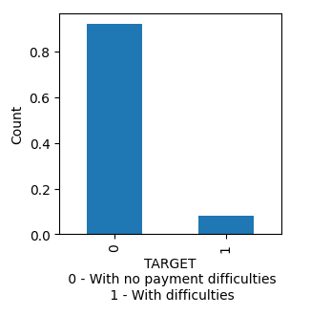
TARGET
More than 90% of the clients have no payment difficulties.

Slide 5
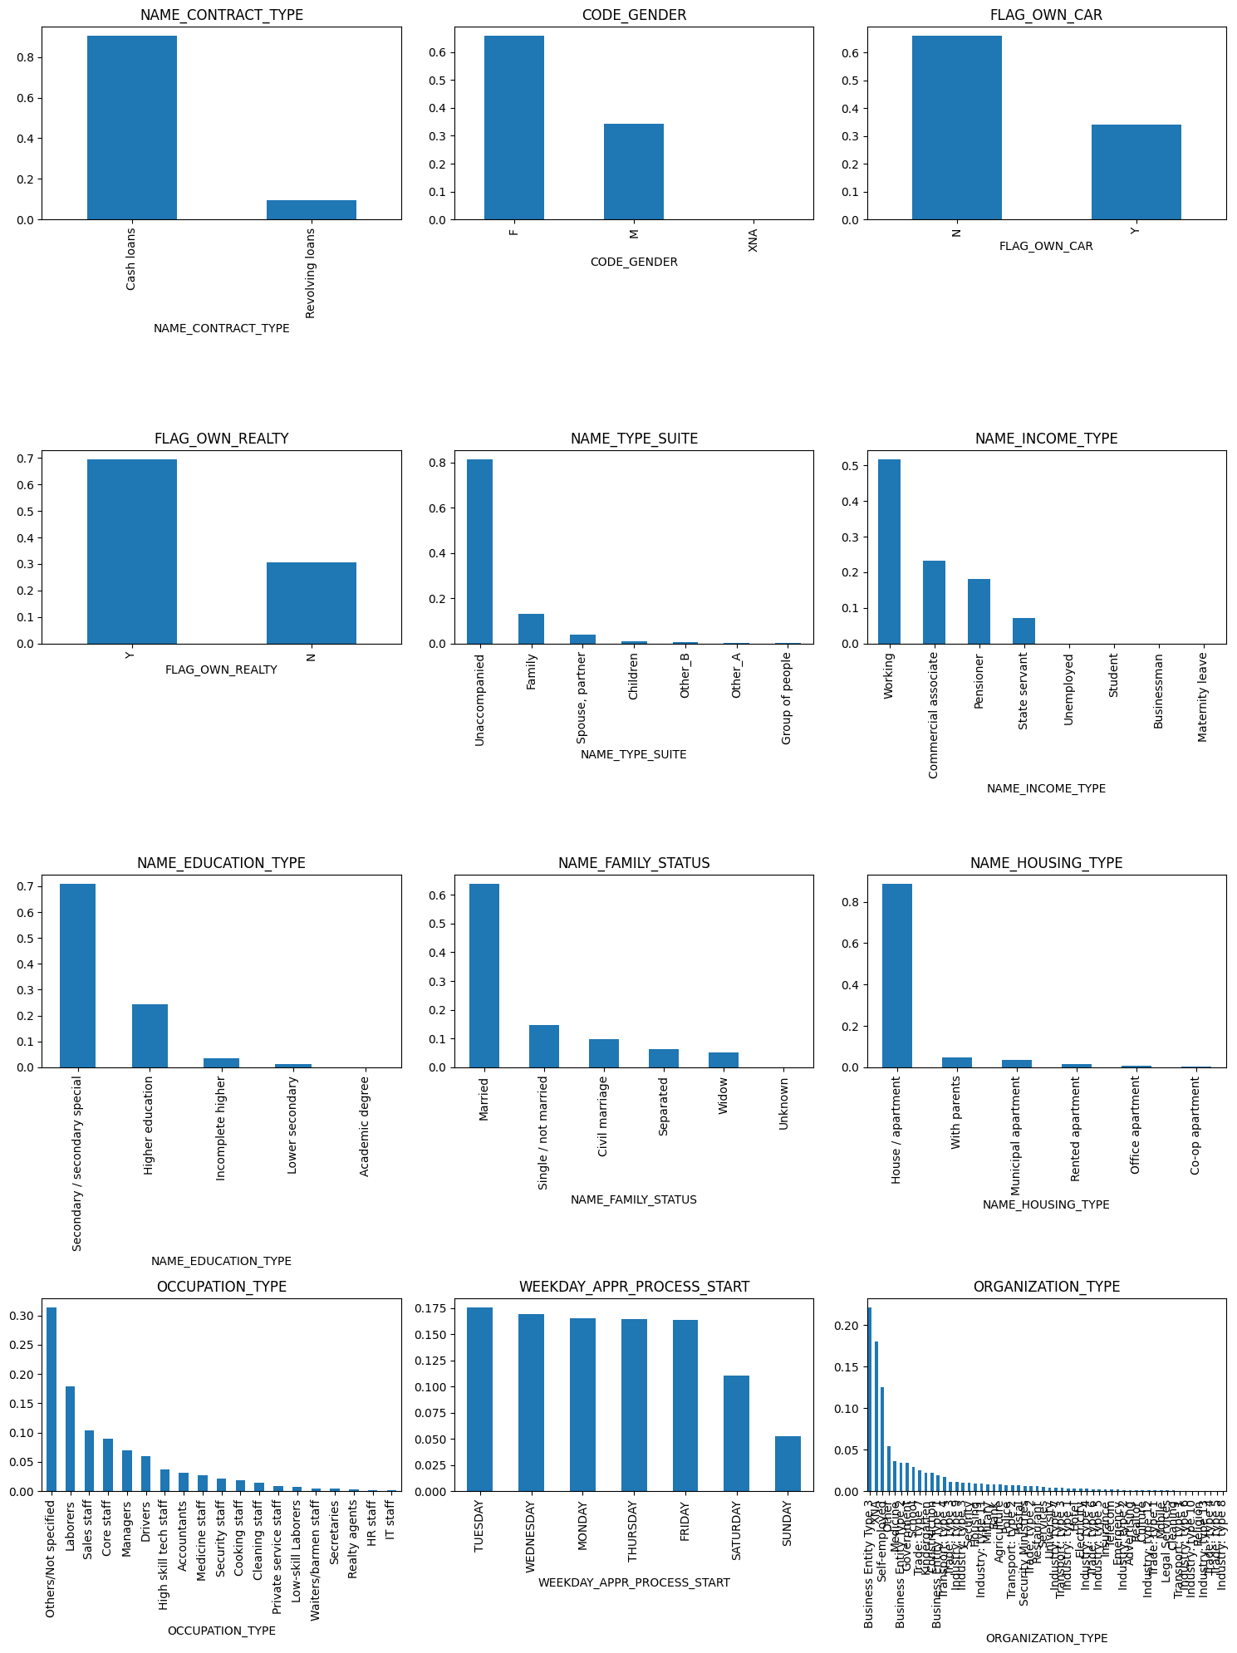
Subplot for all Categorical Variables
I. Cash Loans are offered more than Revolving loans at 90% and 10% respectuvely II. Females availed loans more than Males at 65% ad 34% each III. Most of the clients dont have car, only 35% own car IV. 69% of clients have own realty V. Almost all of them came unaccompanied to apply for loan VI. Half of the clients are Working and 23% are Commercial associate and 18% are Pensioner VII. 71% of applicants have education level of Secondary and 24% have Hugher Education VIII. 63% of the applicants are Married,indicates probability of married people applying for loans are higher IX. 88% of the clients are living in apartment or house, and have the highest number of applications X. 17% of clients are Laborers, second to occupation type others/Not specified which is at 31%, Laborers apply for loan more than others XI. Tuesday has highest percentage share of application start days with 17.5% and Mon,Wed,Thur and Fri share a similar range of 16% each with sunday having the least applications XII. clients in organization type -Business Entity Type 3 take up 22% of the applications and Self-Employed take up 12% with Industry: Type 8 having the least number applications

Slide 6
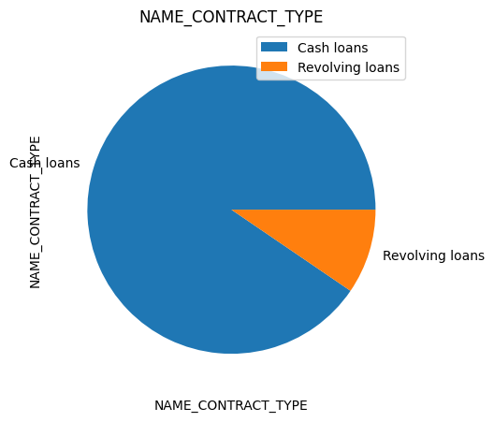
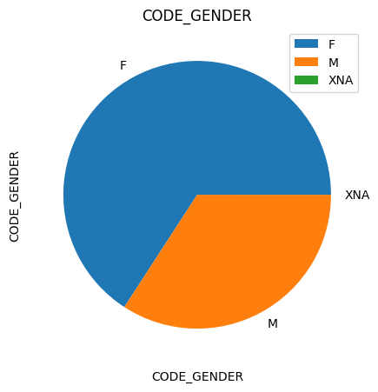
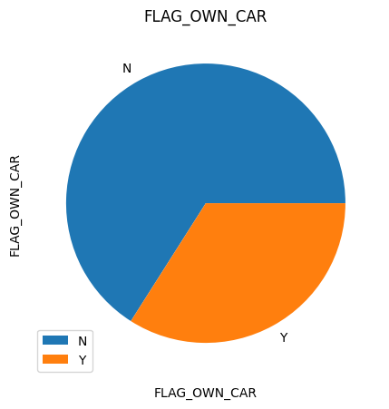
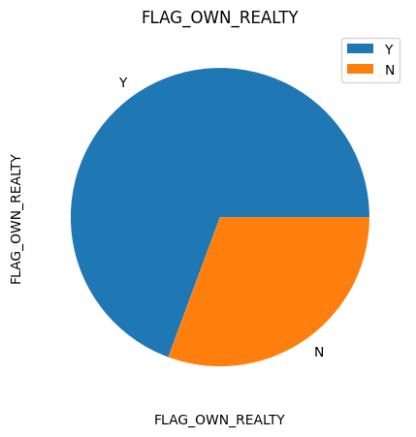
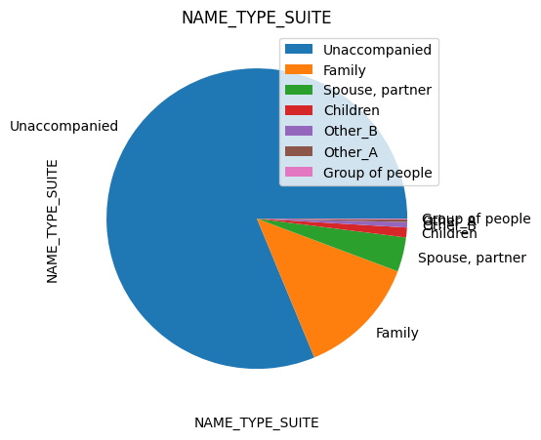
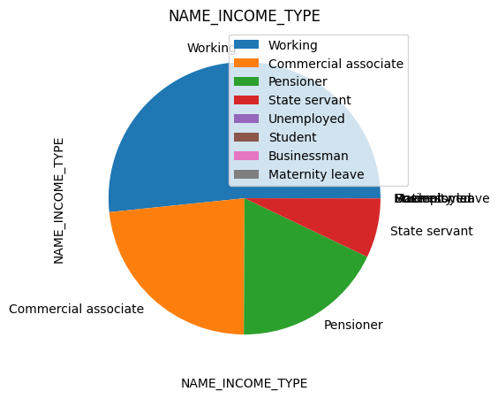
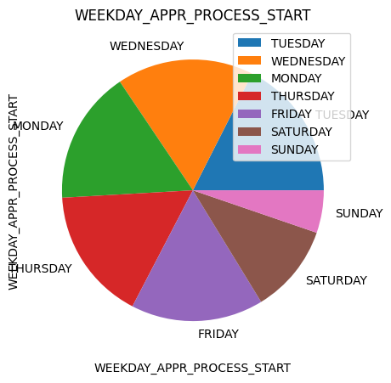
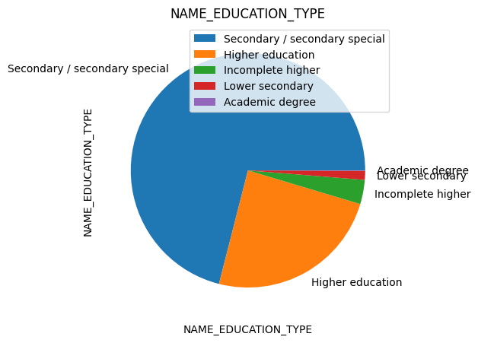
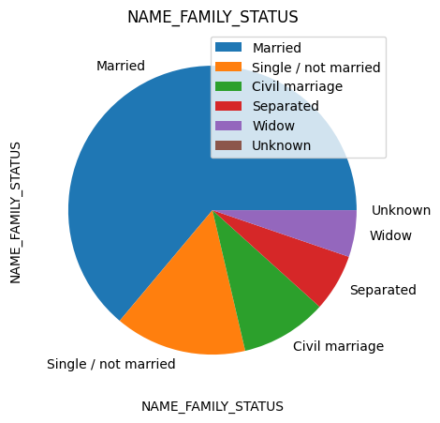
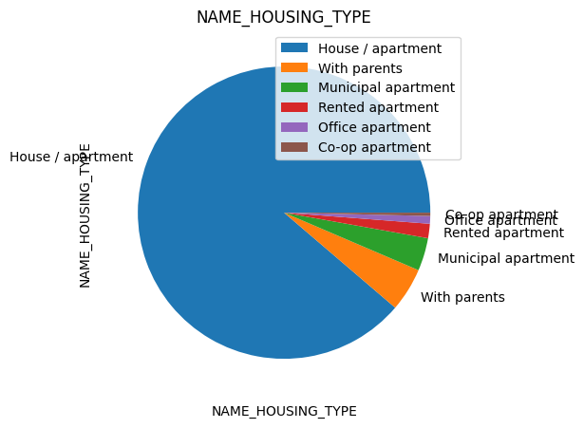

Slide 7
Univariate analysis
Numerical Variables

Slide 8
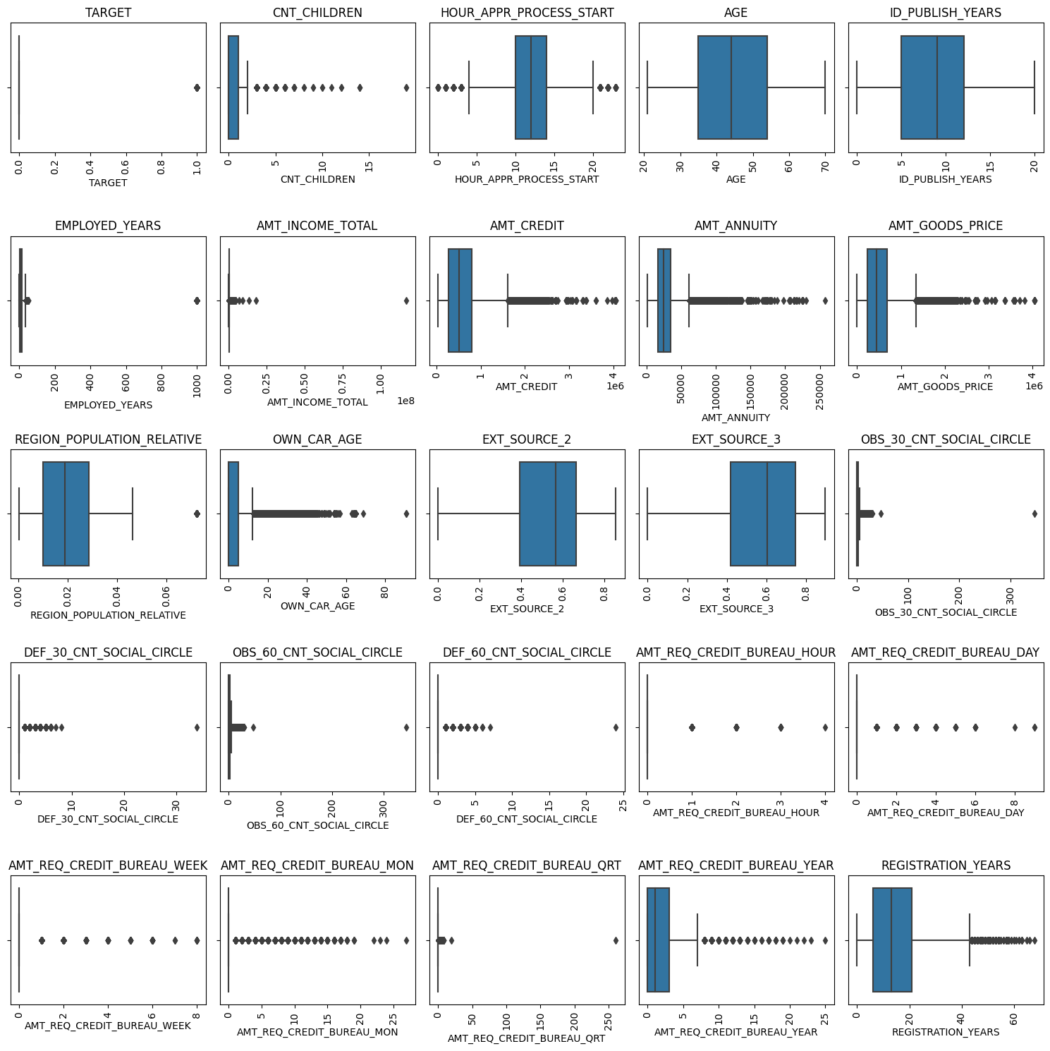
Box plots for all Numerical Variables

Slide 9
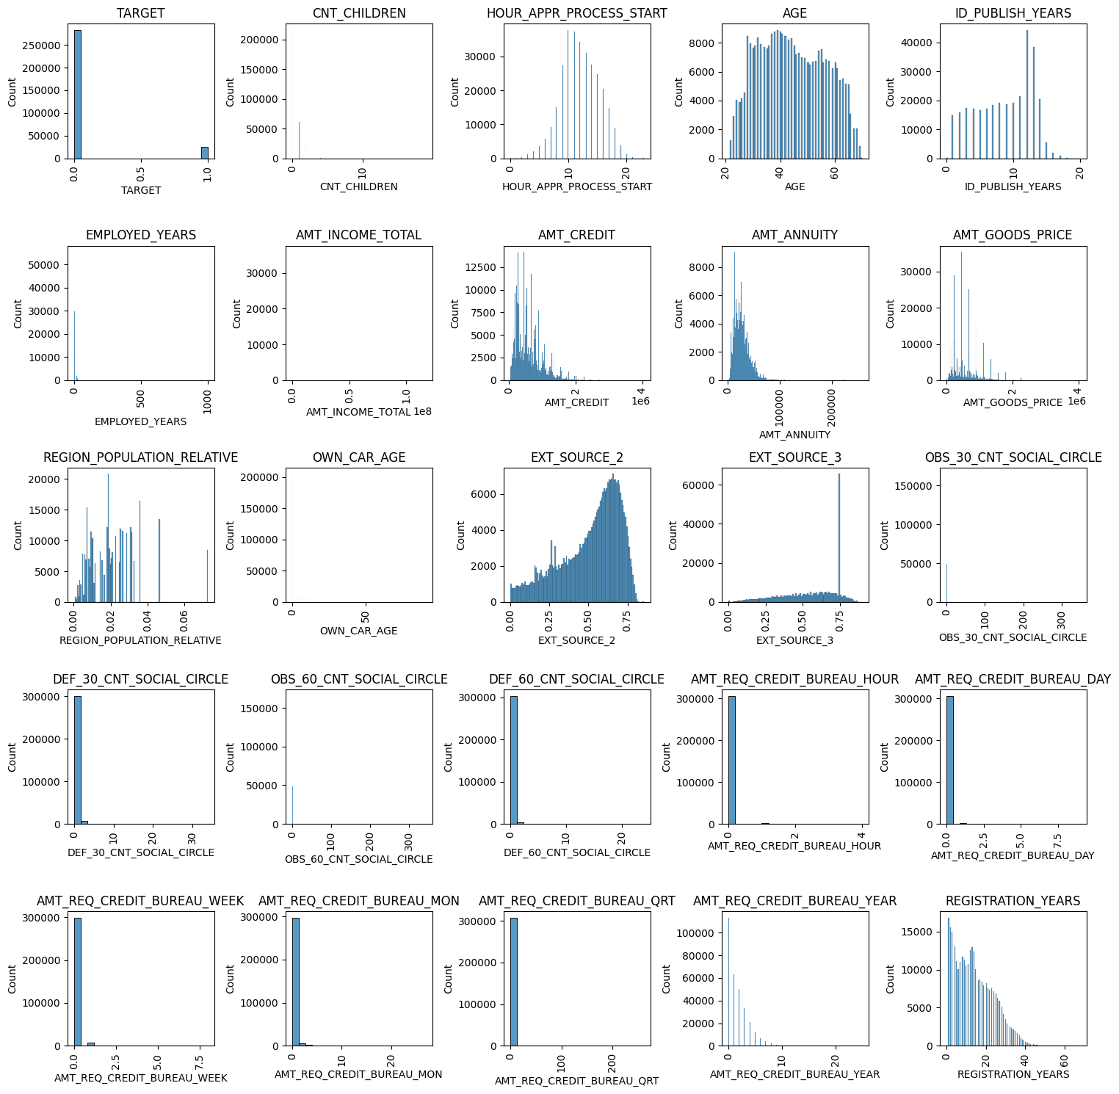
Histogram for all Numerical Variables

Slide 10
Histogram for all Numerical Variables

Slide 11
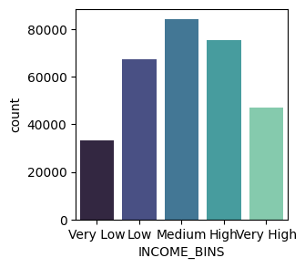
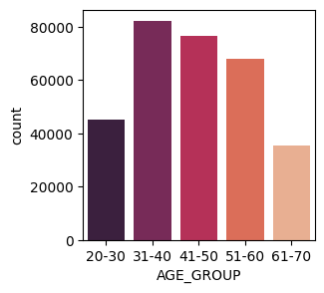
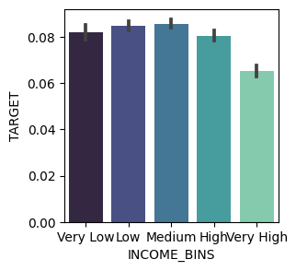
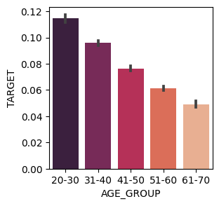
Plots for variables after Creating bins wherever required
Medium salary range has the highest loan applications
People in the age group of 31-40 require Loan more than other age groups,and elderly people above 60 are in least need of a loan
People with Medium range of salary are more likely to have more Payment difficulty
People in Age Group 20-30 are more likely to have more Payment difficulty

Slide 12
Univariate analysis
For Target 0 and Target 1 data frames

Slide 13
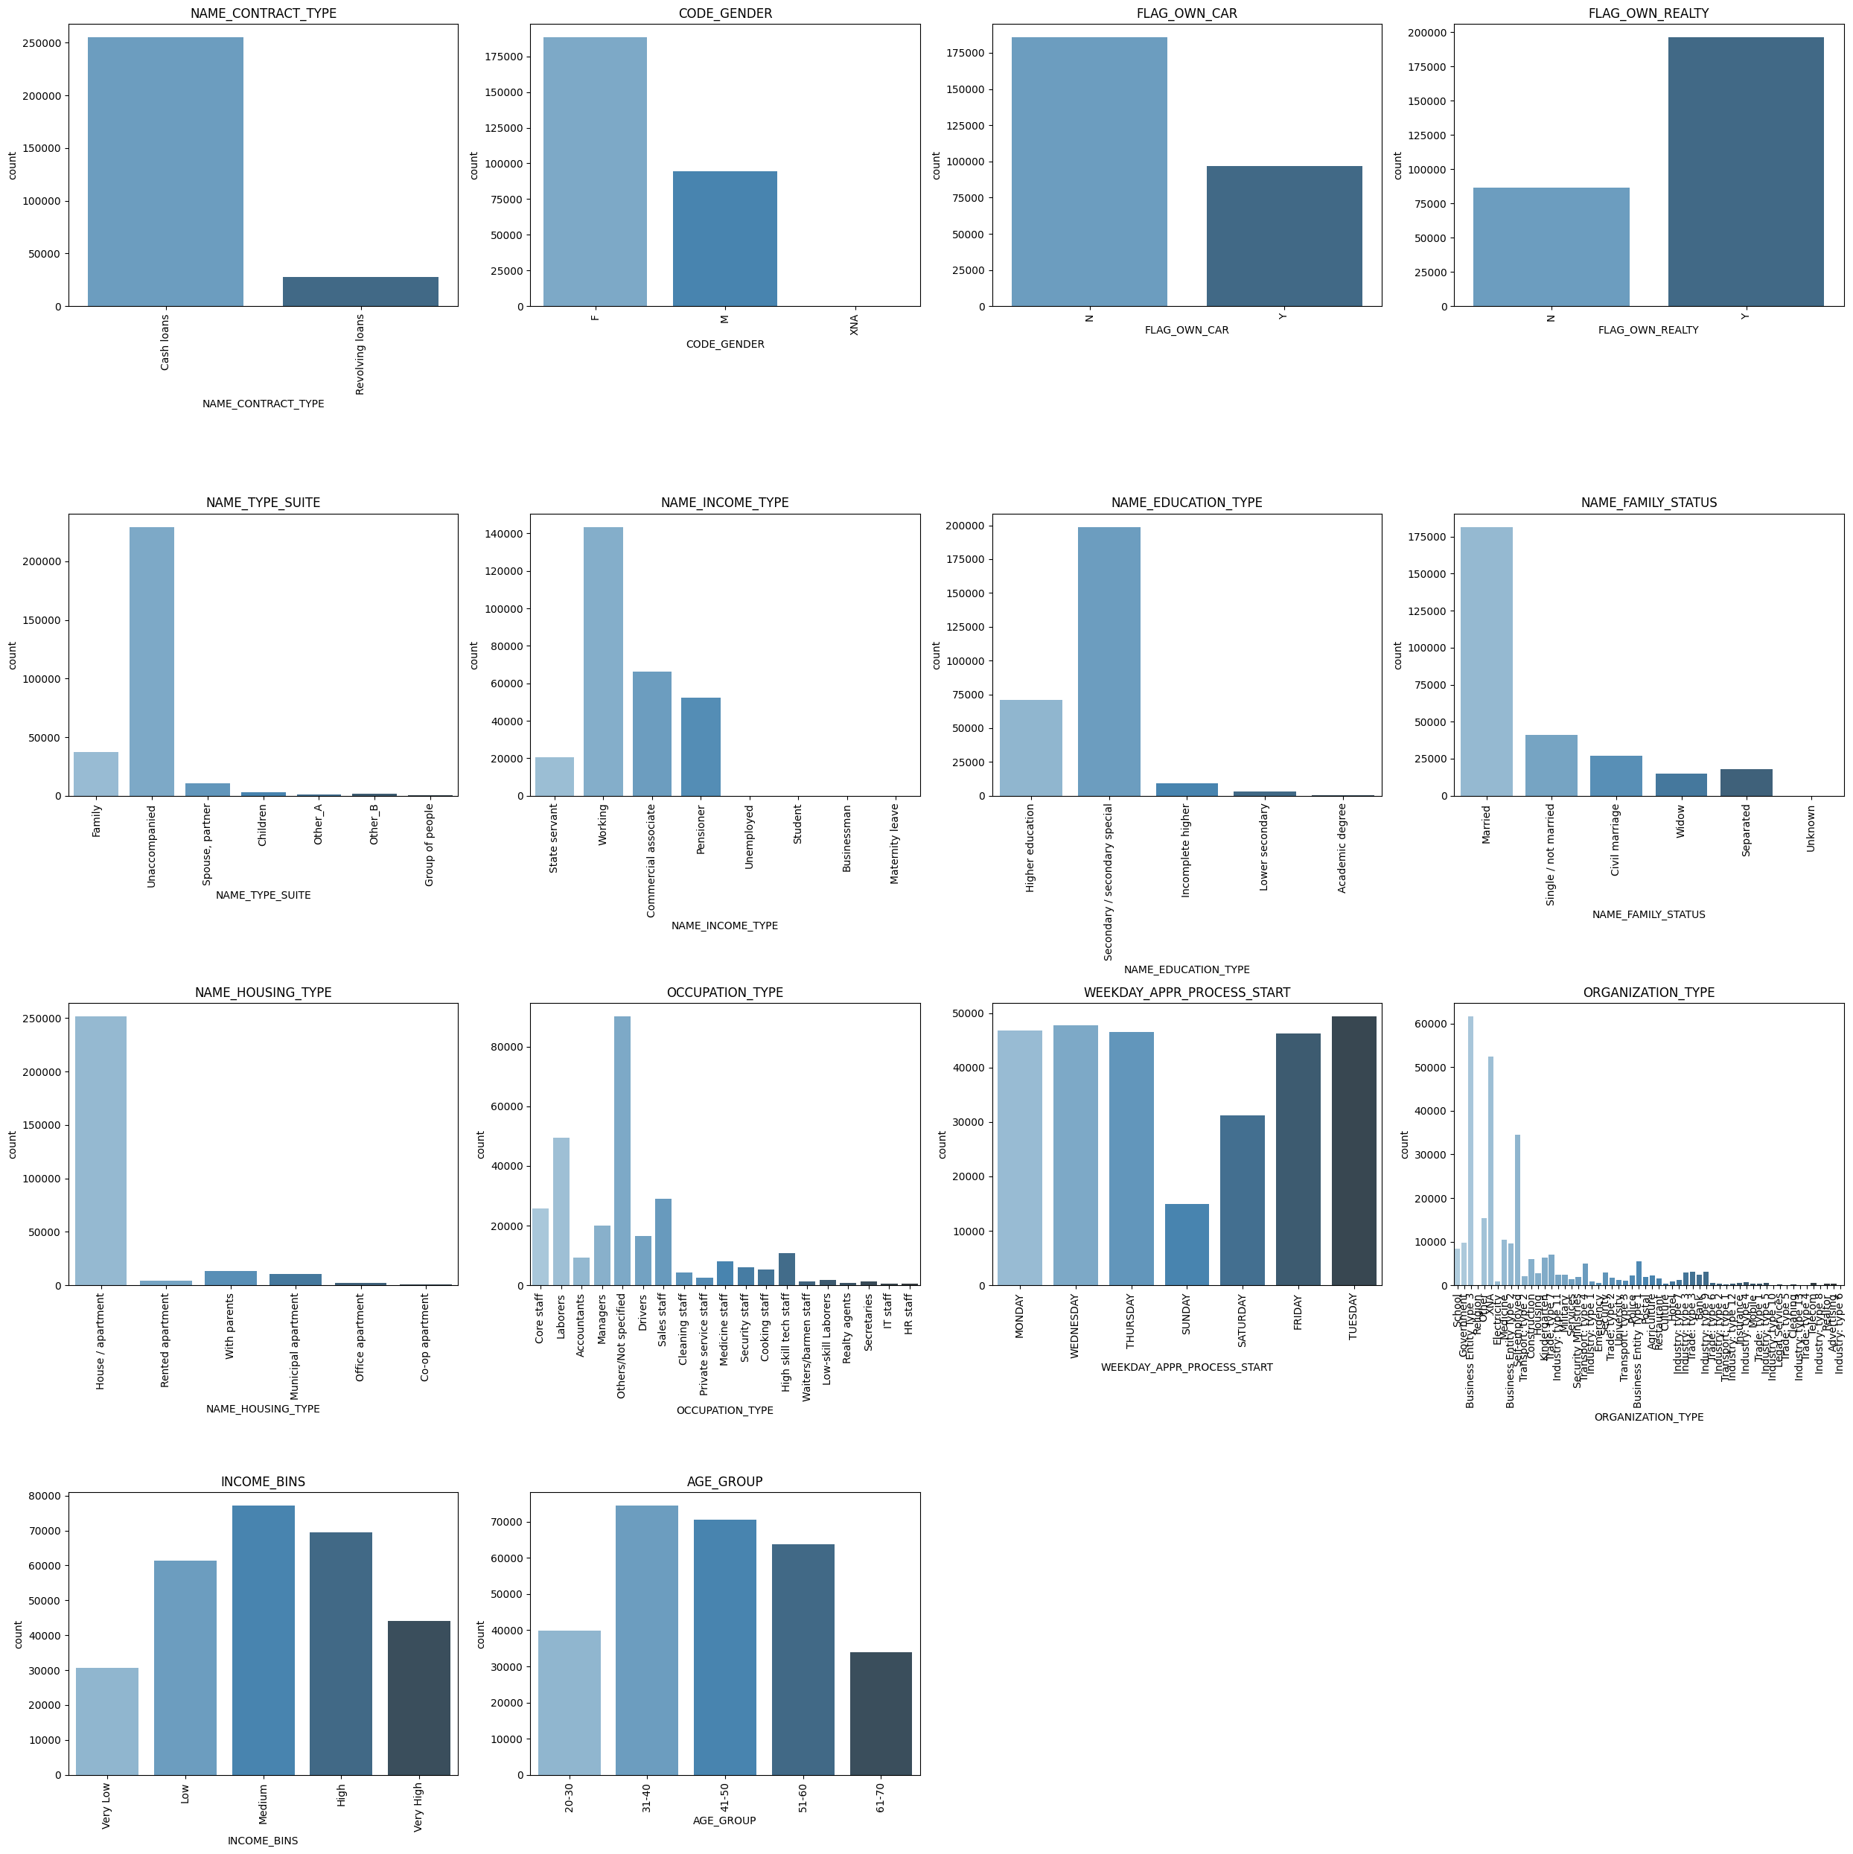
Subplot for all categorical variables for Target 0

Slide 14
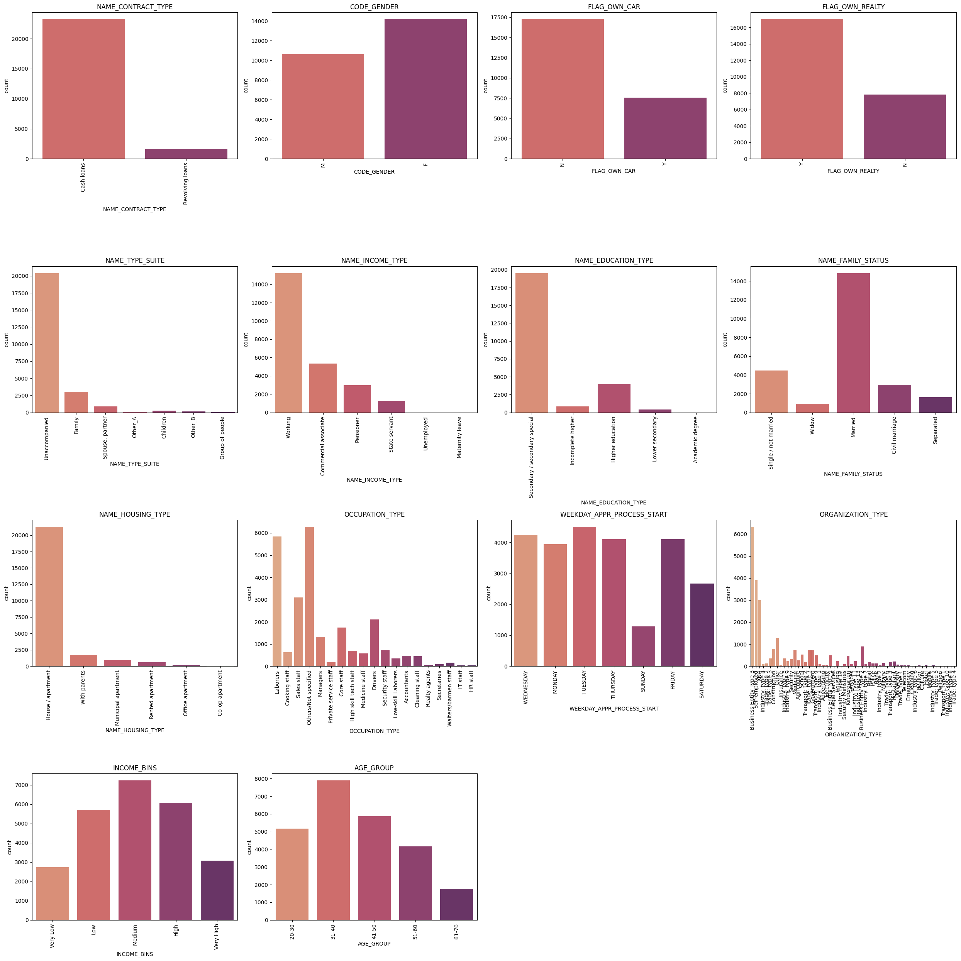
Subplot for all categorical variables for Target 1

Slide 15
Inference for subplots of categorical variables for target 0 & 1
Cash Loans for TARGET-0 is 85% and almost 95% for TARGET-1
80-90% in TARGET-0 and TARGET-1 are applying for loan coming Unaccompanied. No impact of NAME_TYPE_SUIT on TARGET.
50% working in case of TARGET-0 and 60% in case of TARGET-1 are working income types.
For both TARGET-0 and 1,most of clients applying for loan are having Secondary Education .90% of defaulting payments are from applicants with secondary income. Needs further analysis
Almost 60% of people with Payment Difficulties are Married, and Married people take up most share in people With No Payment Difficulties. Indicating Married people apply the mist for Loans, but we cant have a conclusion of the impact over TARGET as they take up greater number in both TARGET-0 and TARGET-1.
85-90% in TARGET-0 and TARGET-1 applicants are staying in "House/apartment". Indicating, this is not a parameter that can influence payment default.
Labourers, sales staff, core staff, drivers constitute of 50% of defaulters. Labourers have highest percentage of applications.
Business ENTITY TYPE 3 AND SELF EMPLOYED add upto 40% defaulters. The highest % of loan takers are also this category.

Slide 16
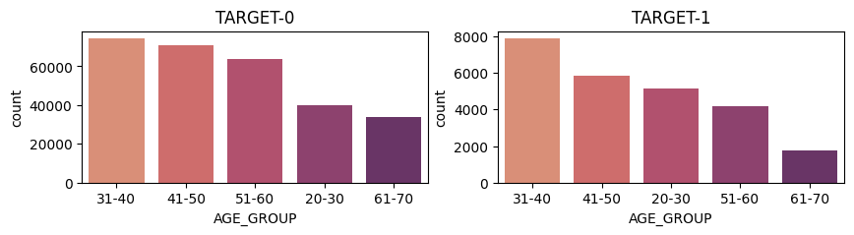
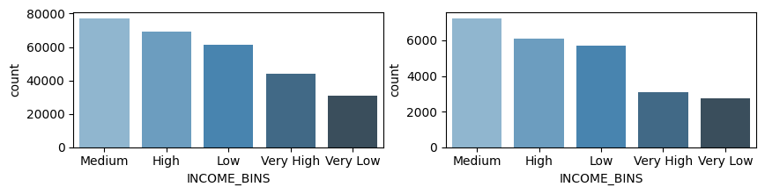
Plotting AGE_GROUP and INCOME_BINS for TARGET-0 and TARGET-1
I. AGE_GROUP 31-40 is highest for both TARGET values, 61-70 having least numbers.
Medium INCOME_BINS is highest for both TARGET values.

Slide 17

Univariate analysis
Continous Numeric Variables

Slide 18
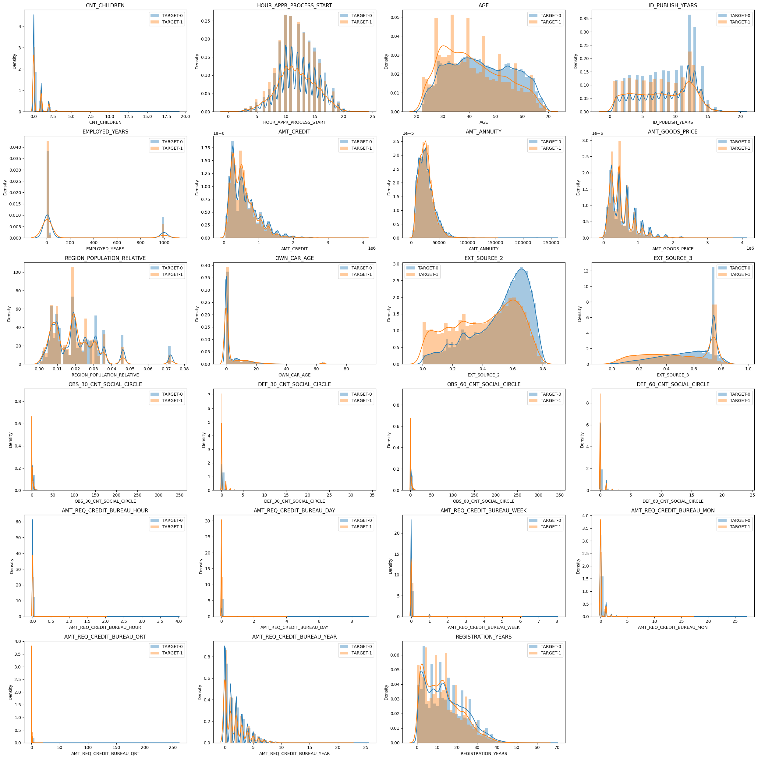
Plotting AGE_GROUP and INCOME_BINS for TARGET-0 and TARGET-1
The density distribution for TARGET-0 and TARGET-1 are very similar for all the continous numeric variables. But we can find that applicants of age 20-40 years are more likely to have payment difficulties, as we can see the TARGET-1 line cover more are and has more density for age from 20-40

Slide 19
bivariate analysis

Slide 20
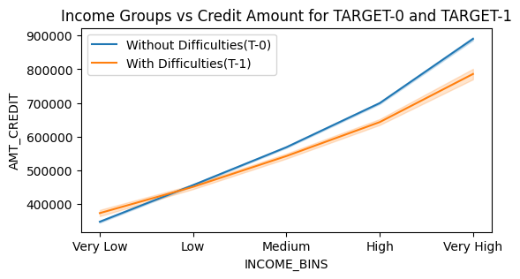
INCOME_BINS vs AMT_CREDIT for TARGET-0 and 1
Credit Amount is directly dependent on Income Range, higher the income higher the credit. We can now understand that the 'Very High' income group although doesnt have defaulters numbers as high as 'Medium' range, the Amount Credited is more and therefore the loss or default amount is more for 'Very High' Income Group.

Slide 21
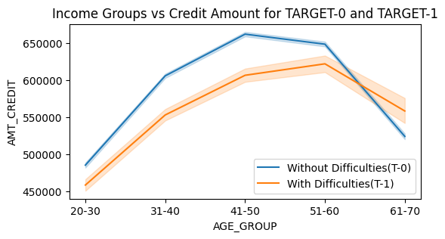
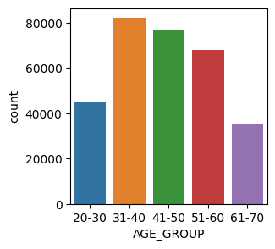
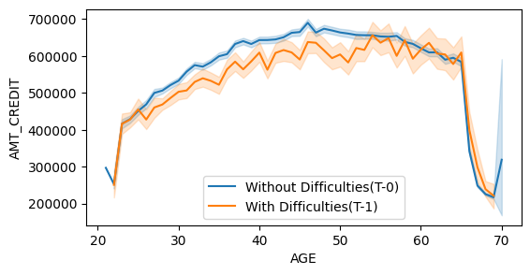
AGE_GROUP vs AMT_CREDIT AND AGE vs AMT_CREDIT for TARGET-0 and 1
The mean amount credited is high for age group 61-70 but the number of applicants for that age group is low , so no inference can be made of this relation

Slide 22
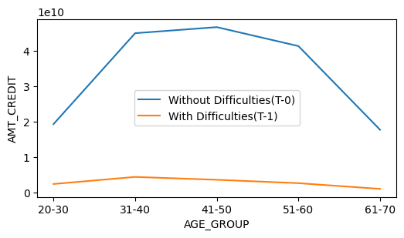
Plotting AGE_GROUP vs AMT_CREDIT with sum of AMT_CREDIT as aggregation.
Age Group 31-40 has the highest defaulting Amount.

Slide 23
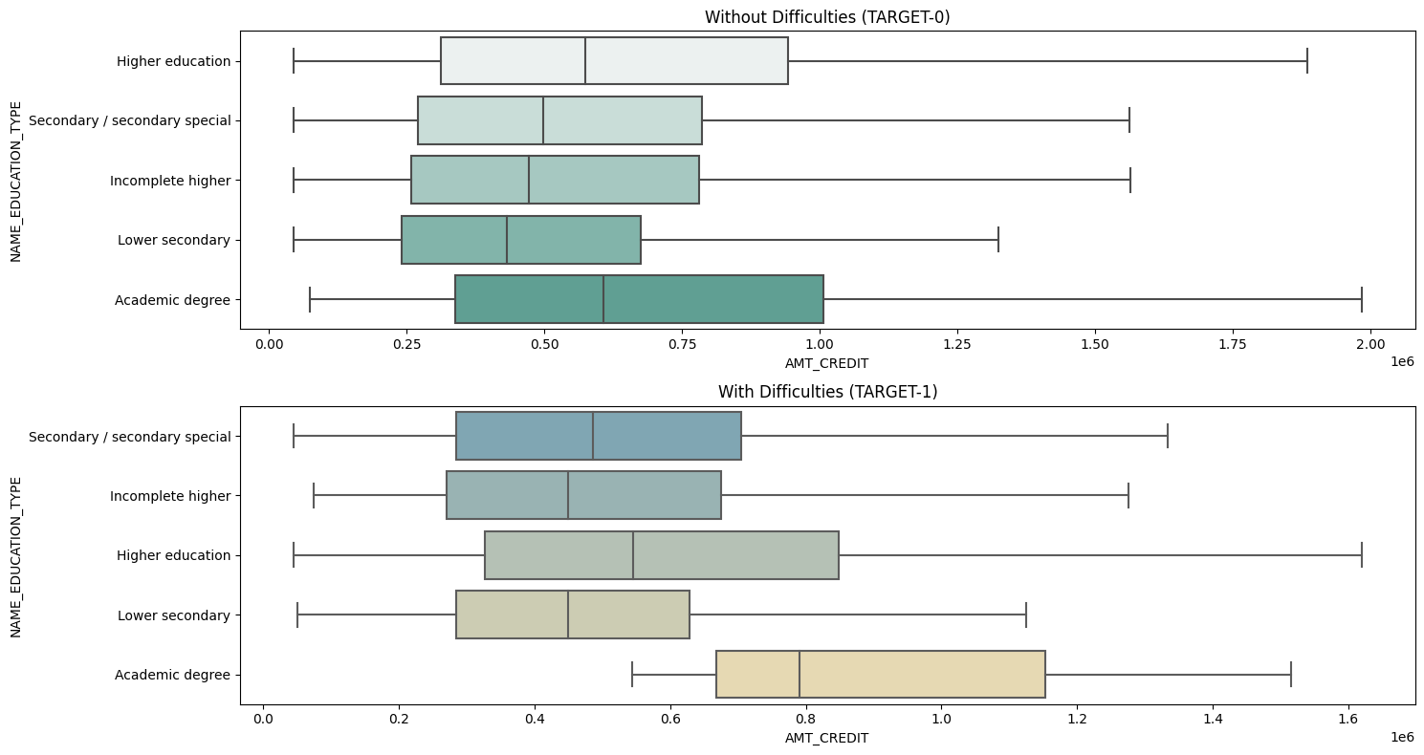
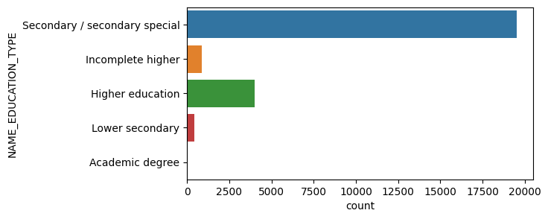
NAME_EDUCATION_TYPE vs AMT_CREDIT
We can see that 'Academic degree' has the higher concentration in higher AMT_CREDIT range and median is more than other Education categories for TARGET-1

Slide 24
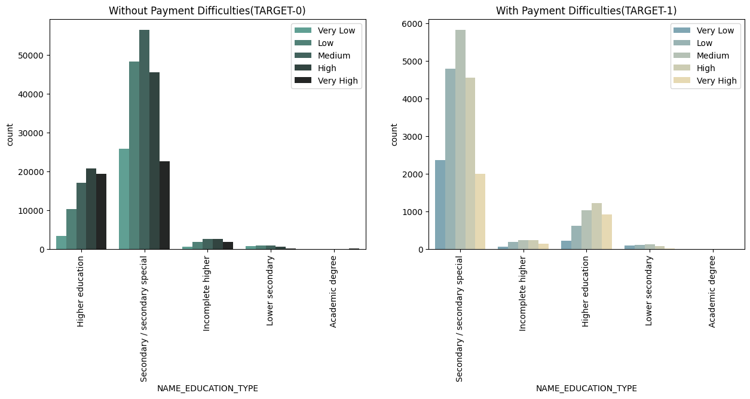
COUNTPLOT FOR NAME_EDUCATION_TYPE WITH INCOME_BINS
We can see that 'Secondary/secondary special' type has high number that others in Defaulters, and 'Medium' Income Range has the highest in all categories.

Slide 25
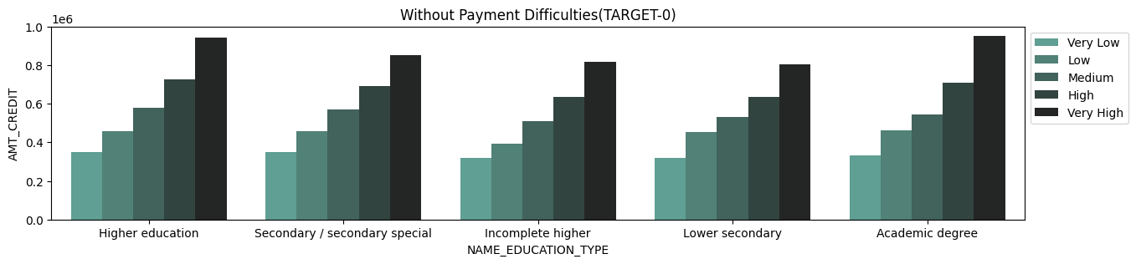
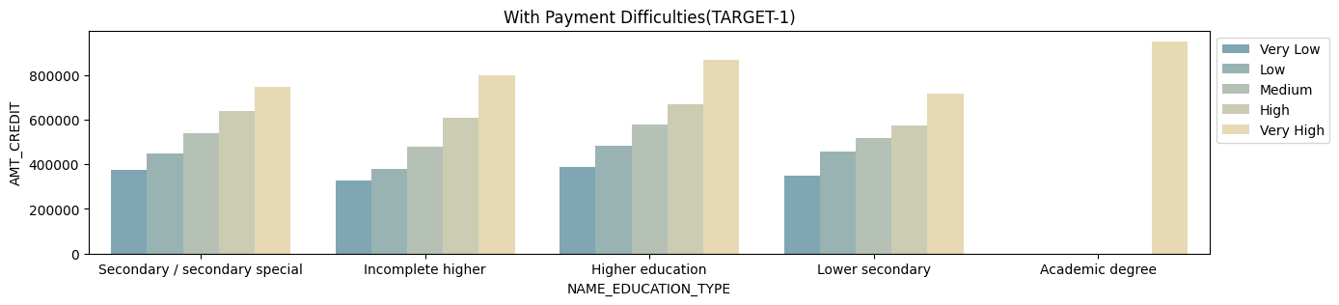
NAME_EDUCATION_TYPE VS AMT_CREDIT
'Very High' Income range in 'Academic Degree' education type has the highest mean of Credit amount with Payment difficulties, indicating that Academic Degree holder with Very High income can default greater amounts.

Slide 26
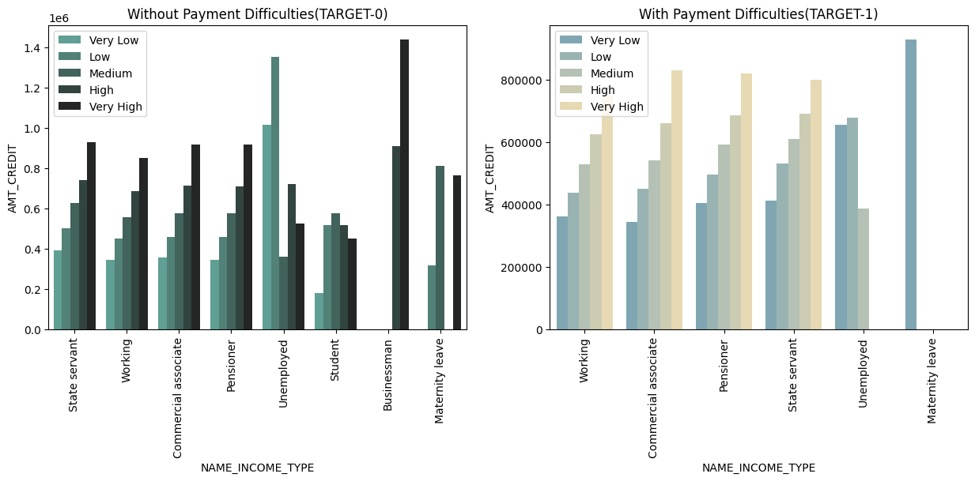
INCOME_BINS, NAME_INCOME_TYPE and AMT_CREDIT
People in maternity leave have larger credit amount mean in TARGET-1 data, people in maternity leave are mre likley have payment difficulties compared to others and the default amount can be bigeer than others.

Slide 27
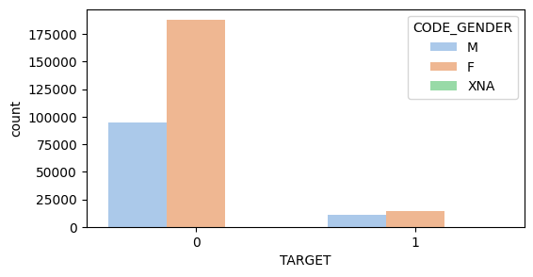
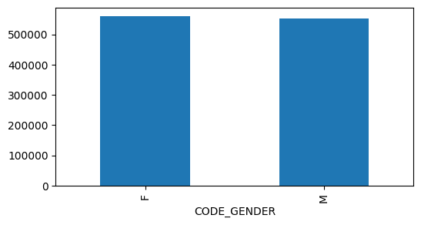
Gender vs Target
Eventhough the highest number of applicants is Females, the average Credit Amount for client with payment difficulties is almost similar for both Male and Females, which implies that Males are more likely to have payment difficulties for higher credit ammount, meaning Males have greater Defaulting amount ratio.

Slide 28
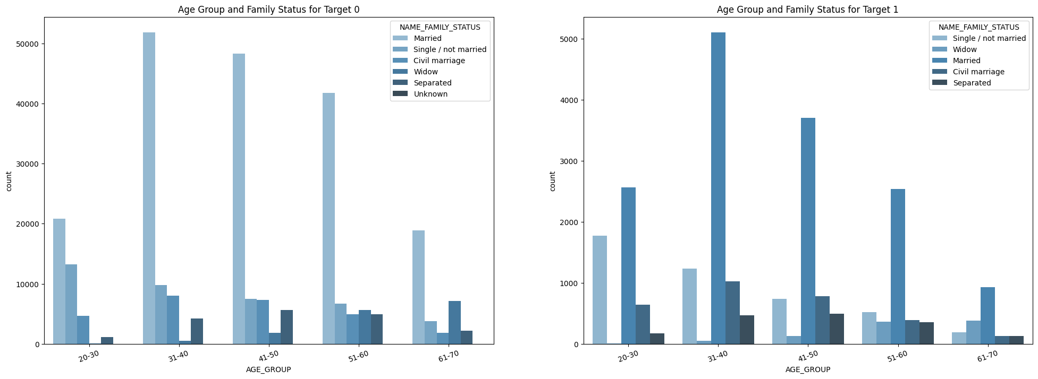
AGE_GROUP and NAME_FAMILY_STATUS
Married applicant in the age group 25-35 amd 35-45 is the largest group of applicant with payment difficulties.

Slide 29

Correlation between variables in TARGET-0 and TARGET-1

Slide 30
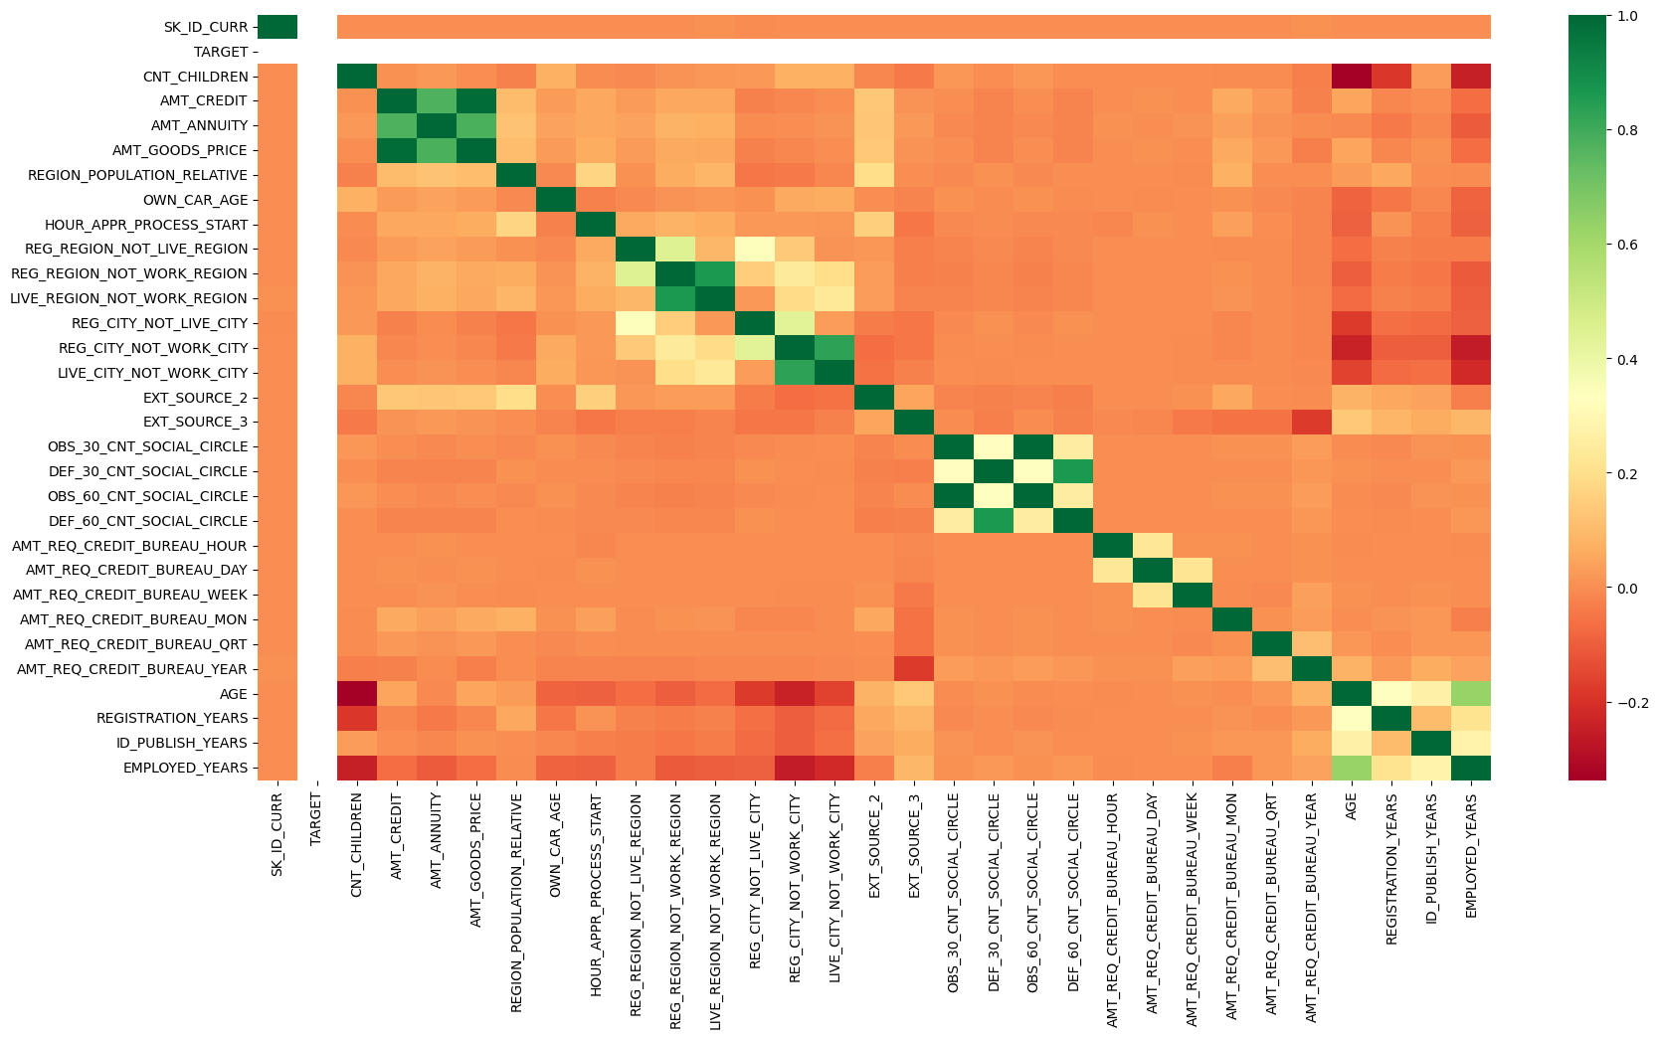
Correlation between variables in TARGET-0

Slide 31
Correlation between variables in TARGET-1

Slide 32
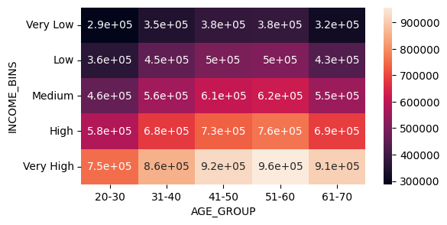
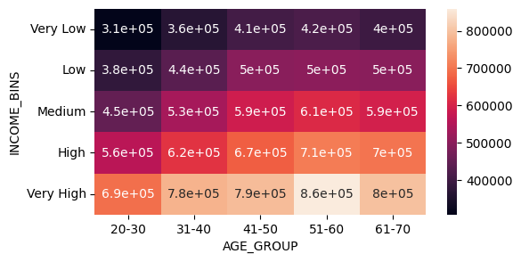
INCOME_BINS VS AGE_GROUP AGGREGATED ON AMT_CREDIT FOR MEAN
TARGET-0
TARGET-1

Slide 33
PREVIOUS APPLICATION

Slide 34
Univariate analysis
Categorical Variables

Slide 35
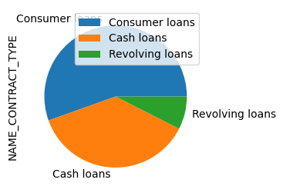
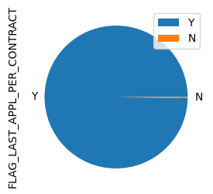
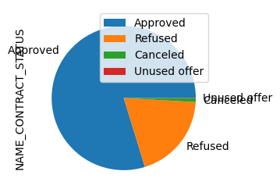
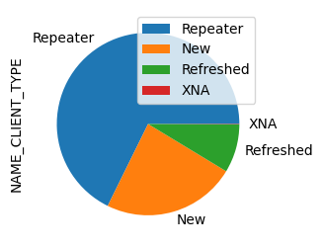
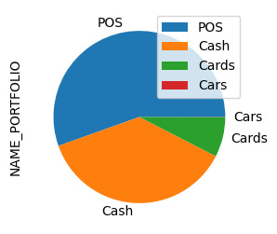
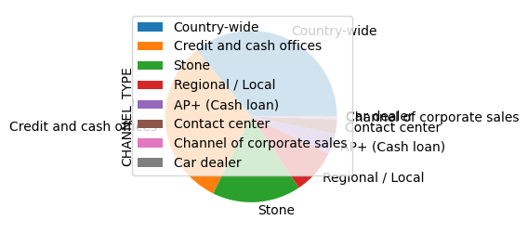
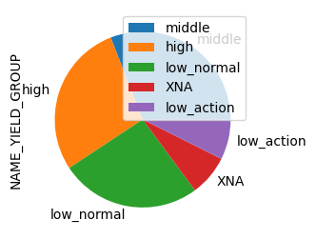
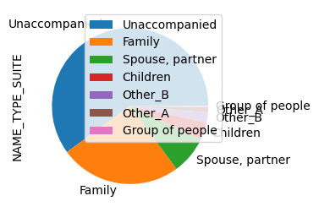

Slide 36
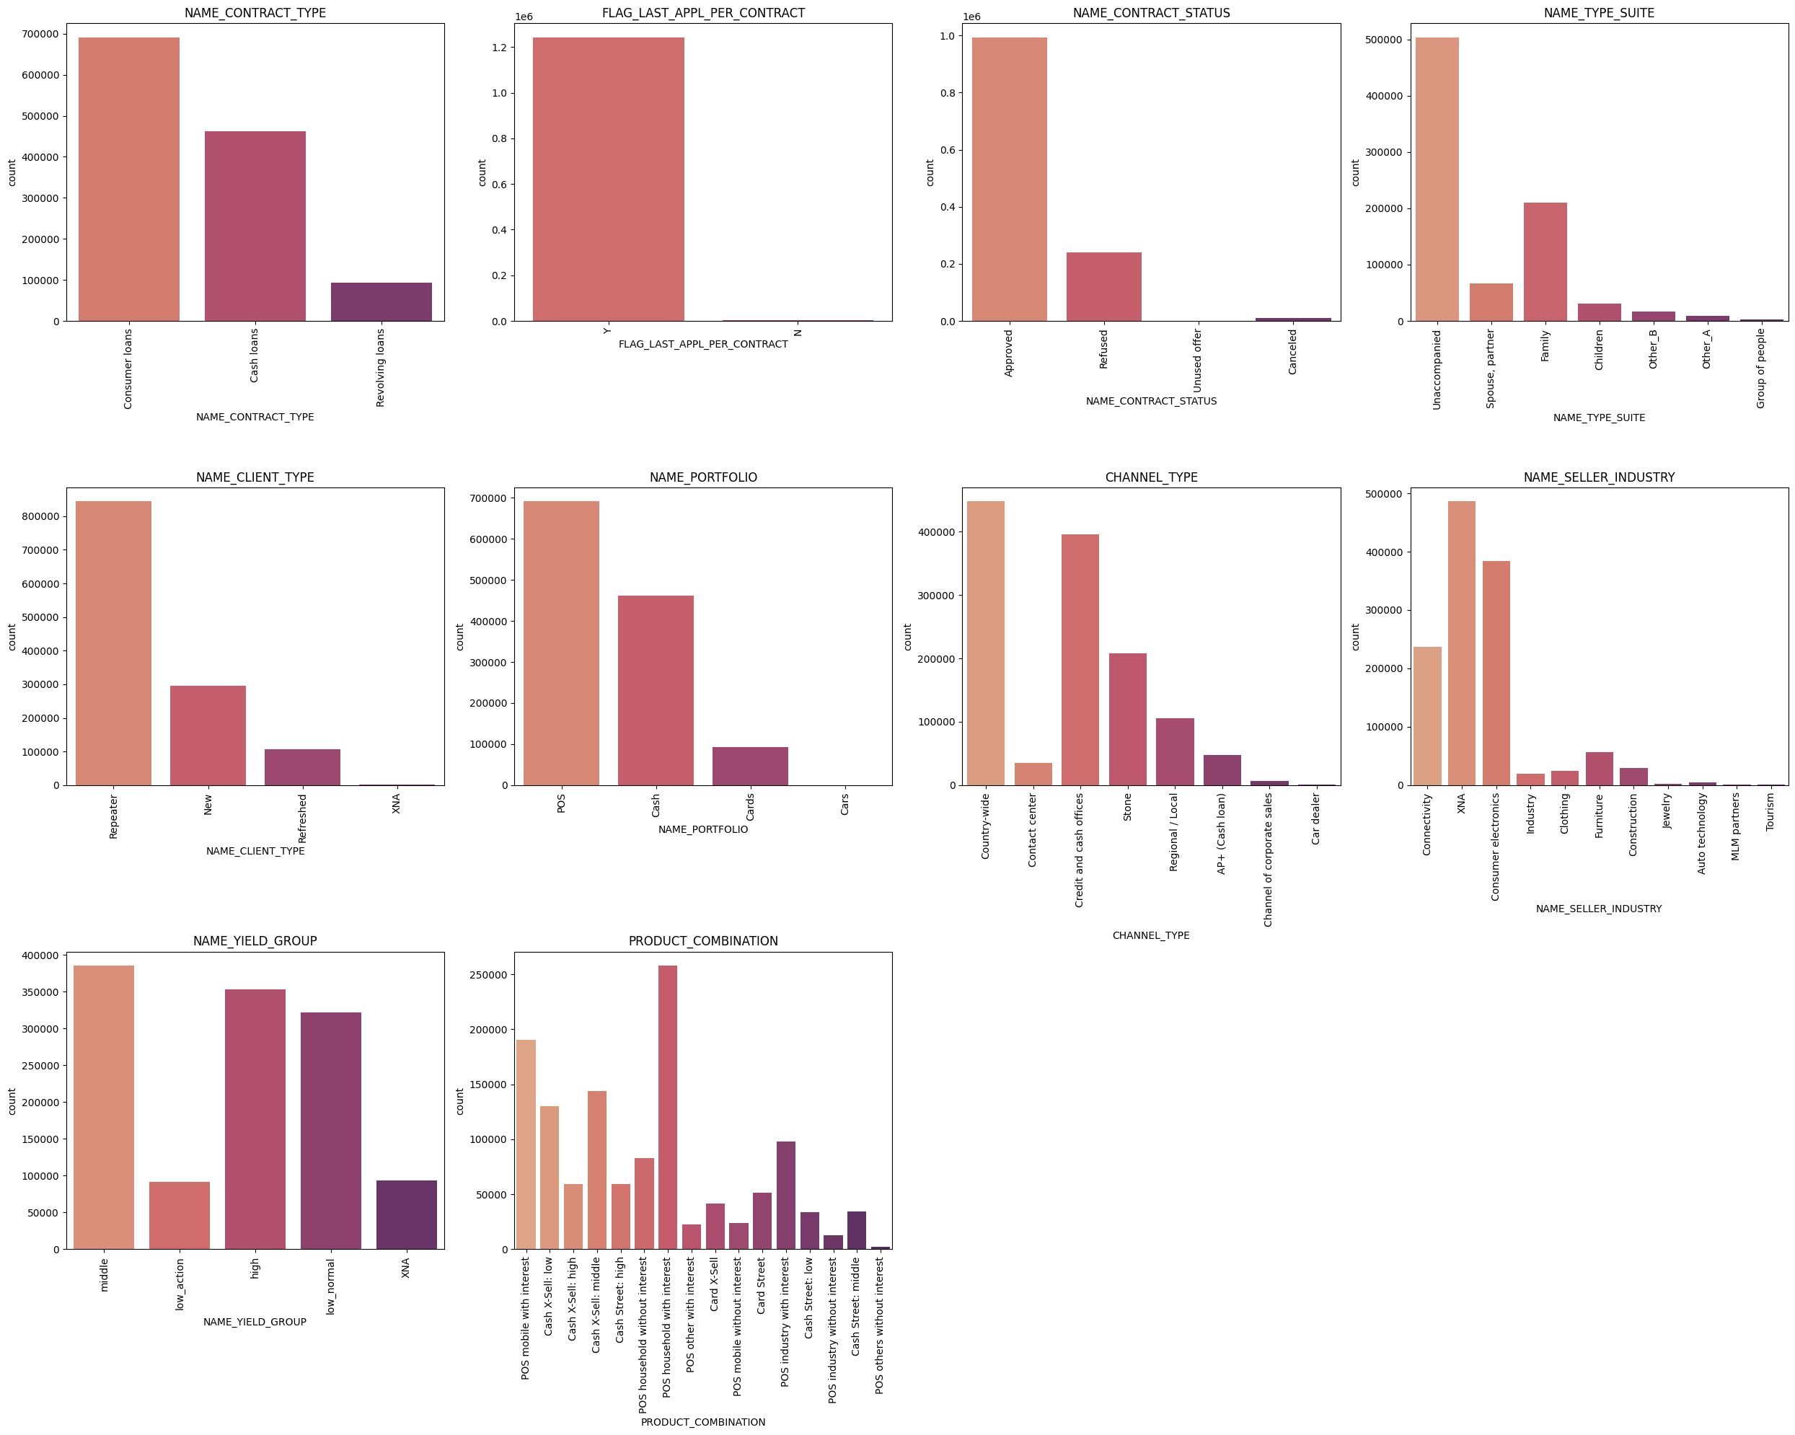
Subplot for all categorical variables
There is a new type of loan called Consumer Loan, which is not present in Application data . 55% of loans are consumer loans. 37% cash loans and remaining are revolving
Approved loans are 79% and remaining is refused, cancelled and unused.
67% are repeaters. NAME_CLIENT_TYPE also has some null values showing as XNA.
CHANNEL_TYPE 'Country Wide' has more number of applicants.
POS has highest number for NAME_PORTFOLIO.
55% of the applicants have taken loan for POS purchase.
Name seller industry has 37% XNA values, Consumer electronics is next highest category at 30%.

Slide 37
Univariate analysis
Numerical Variables

Slide 38
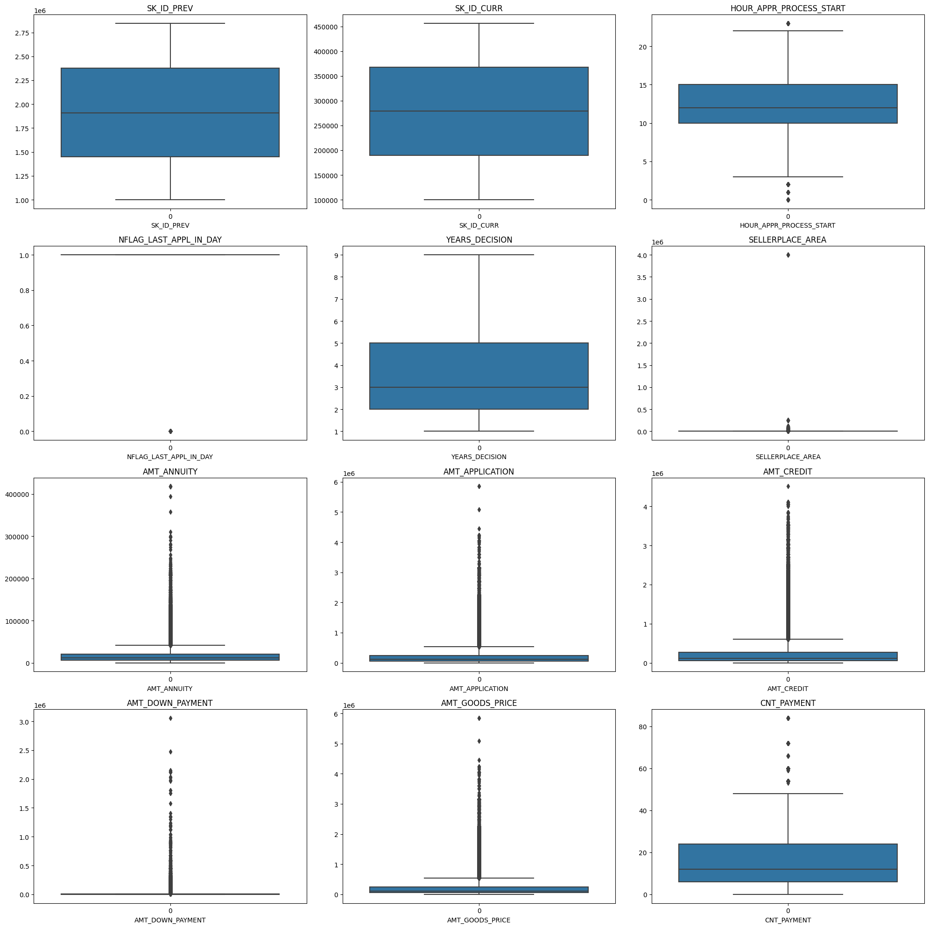
Box Subplot for all numerical variables

Slide 39

distribution graph for all numeric variables.
HOUR_APPR_PROCESS_START is similar to Application data HOUR_APPR_PROCESS_START, highest at 10-12
Most of the application will be decided to be approved or rejected in 1-2 years, although a few of them might go upto 8 years.
Density of CNT_PAYMENT is higher at 5-10 term. Which means most of the previous loan applied are for 5-10 terms.

Slide 40
bivariate analysis

Slide 41

Subplot for all Categorical Variables plotted for NAME_CONTRACT_STATUS
Most of the Loans applied get accepted.
Clients who come unaccompanied to apply loans have the highest approval rate.
Repeaters get most loan approvals.
POS portfolio get most loan approval among other NAME_PORTFOLIOs whereas Cash has highest Refusals.
Country-wide CHANNEL_TYPE has the greatest number of approvals and has lesser number of rejections. 'Credit and Cash offices' have highest number of Rejections.
Consumer Electronics gets highest approvals in Seller Industries.
'POS household without internet' has highest approvals and ;Cash X-sell:low' has highest refusal.

Slide 42
Multivariate Analysis

Slide 43

Pair-plot for 'AMT_GOODS_PRICE','AMT_APPLICATION','AMT_CREDIT','AMT_ANNUITY','CNT_PAYMENT' to check the correlation of numeric variables.
AMT_APPLICATION and AMT_GOODS_PRICE has the highest correlation.
AMT_APPLICATION, AMT_GOODS_PRICE, AMT_AMT_CREDIT, AMT_ANNUITY has good correlation with eachother.
All these 4 variables are directly proportional to each other.
Higher the value of good purchased more will be the need for higher loan amount.

Slide 44

Subplot for Heatmaps of NAME_CONTRACT_STATUS vs NAME_CLIENT_TYPE aggregated over AMT_APPLICATION and AMT_CREDIT
From this heatmap we can understand that the loan amount cancelled is higher than Refused which is higher than Approved.
Even though the number of Approvals are higher, the Application amount and credit amount is lower than Refused and Cancelled.
Highest Number of Cancels in both are from XNA, and it needs more information about why these records are Null or XNA and what meaningful value could replace it
Among all the client types, Repeater gets the highest amounts of approvals next come Refreshed.
Unused Loan application amount and credit amount is lower

Slide 45

Subplot for Heatmaps of NAME_CONTRACT_STATUS vs NAME_PORTFOLIO aggregated over AMT_APPLICATION and AMT_CREDIT
There is no Unused offer for 'Cards', 'Cars' and 'Cash', and very low Unused Offer Amount 'POS’
The highest Application and Credit Amount is for cars, and the highest Approved, Cancelled and Refused amount is all for 'Cars,
The number of Applications for 'Cars' is significantly lower than all the other Portfolios, with POS having the highest number, but eventhough Cars has such low applications, the Goods Amount , Application Amount and Loan Amount is bigger than all the other portfolios.
Banks need to focus on Cars more as they have highest amount.

Slide 46

Correlation between variables in previous application data

Slide 47
APPLICATION DATA & PREVIOUS APPLICATION (MERGED)

Slide 48
analysis

Slide 49


NAME_CONTRACT_STATUS and TARGET
7.5% of Approved Loans have Payment difficulties.
Refused Previous application loans have the highest default percentage of 11.5% in current application data.

Slide 50



NAME_CONTRACT_STATUS and TARGET (Approved and not approved)
The percentage of Default is higher in ‘Not Approved’ applications.

Slide 51
Analyzing for number of Defaults in different categorical cases

Slide 52

NAME_CONTRACT_STATUS and NAME_INCOME_TYPE over count of target-1
The Working income type has the highest number of defaulters in 'Approved’.
The working income type also has highest number of defaulters even in 'Refused' -which means the loan was granted to these applicants eventhough it was previously 'Refused' which clearly shows that more inspection is need before granting loan to applicants who were previously Refused.
Similarly we can see in other cases as well, that the Default rate or count is higher for previously 'Refused', ex: Commercial associate Income type has second highest defaulters concentration in Refused.
It is clear through the heatmap that Previously Refused clients are more likely to default.

Slide 53

NAME_CONTRACT_STATUS and NAME_EDUCATION_TYPE over count of target-1
I. 'Secondary/secondary special' has the highest number of defaults both in 'Approved' and 'Refused’.
The Defaulter number is higher in 'Refused' in all those cases that have higher applicants, meaning people who were previously Refused are more liekly to default.

Slide 54

NAME_CONTRACT_STATUS and INCOME_BINS over count of target-1
Medium Income range has the highest defaulters numbers.
As observed in previous cases also the Defaulters rate is higher in previous contract status Refused.

Slide 55

NAME_CONTRACT_STATUS and AGE_GROUP over count of target-1
31-40 and 41-50 has the highest nujber of defaulters.
As senn in other cases aboce, Defaulters number is high for previous contract status 'Refused'.

Slide 56

NAME_CONTRACT_STATUS and NAME_FAMILY_STATUS over count of target-1
Married has highest number of applicants and hence highest number of Defaulters in Approved and in Refused.

Slide 57
Analysing for Default amount for different previous contract status

Slide 58

NAME_CONTRACT_STATUS and NAME_INCOME_TYPE over mean of amt_credit
Income Type Maternity Leave has the highest and second highest default amount mean, and the highest default amount comes from previously Refused contract status.

Slide 59

NAME_CONTRACT_STATUS and NAME_EDUCATION_TYPE over mean of amt_credit
Education type Academic degree has the highest default amount, and it falls in previously Approved status

Slide 60

NAME_CONTRACT_STATUS and INCOME_BINS over mean of amt_credit
Very High income range has the highest defasult amount mean, and it falls in Cancelled status.
Every previous contract status for Very High income range has high default amount, because the credit amount is higher for higher income ranges.

Slide 61

NAME_CONTRACT_STATUS and AGE_GROUP over mean of amt_credit
Age group 51-60 has highest default amount and most of it is previously Cancelled status.

Slide 62

NAME_CONTRACT_STATUS and NAME_FAMILY_STATUS over mean of amt_credit
Married Family status has highest Default amount and most of it concentrated in previosuly Cancelled contract status.

Slide 63

Correlation between variables in merged data frame

Slide 64
summary
Case Summary
Defaulters' demography
All the below variables were established in analysis of Application dataframe as leading to default.
Checked these against the Approved loans which have defaults, and it proves to be correct
-Medium income
-25-35 years ols , followed by 35-45 years age group
-Male
-Unemployed
-Labourers, Salesman, Drivers
-Business type 3
-Own House - No
Other IMPORTANT Factors to be considered
-Days last phone number changed - Lower figure points at concern
-No of Bureau Hits in last week. Month etc – zero hits is good
-Amount income not correspondingly equivalent to Good Bought – Income low and good value high is a concern
-Previous applications with Refused, Cancelled, Unused loans also have default which is a matter of concern. This indicates that the financial company had Refused/Cancelled previous application but has approved the current and is facing default on these.
Credible Applications refused
-Unused applications have lower loan amount. Is this the reason for no usage?
-Female applicants should be given extra weightage as defaults are lesser.
-60% of defaulters are Working applicants. This does not mean working applicants must be refused. Proper scrutiny of other parameters needed
-Previous applications with Refused, Cancelled,Unused loans also have cases where payments are coming on time in current application. This indicates that possibly wrong decisions were done in those cases.

